Slide 1

JavaScript Basics

Slide 2
JavaScript
For JavaScript, you should know the basic language i.e., HTML and CSS.
JavaScript is the programming language of HTML and the web. It makes web page dynamic. It is interpretated programming language with object oriented capabilities.

Slide 3
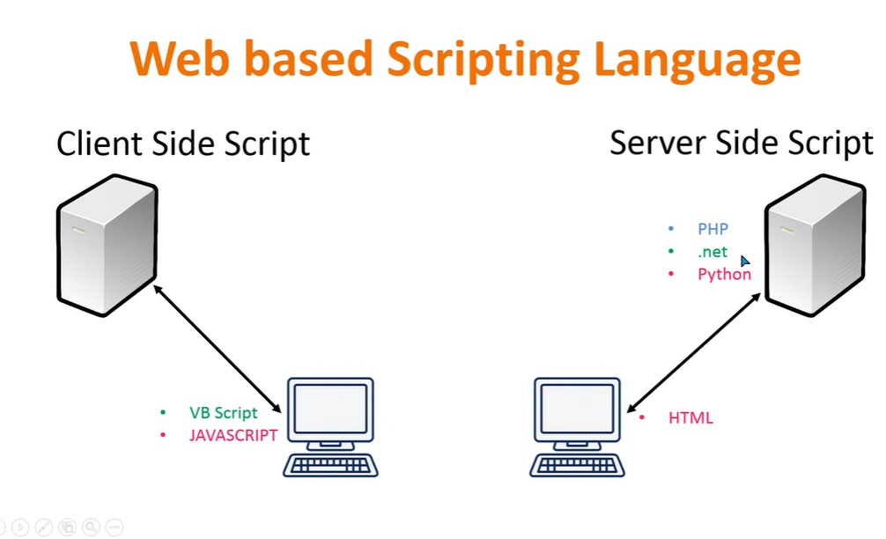

Slide 4
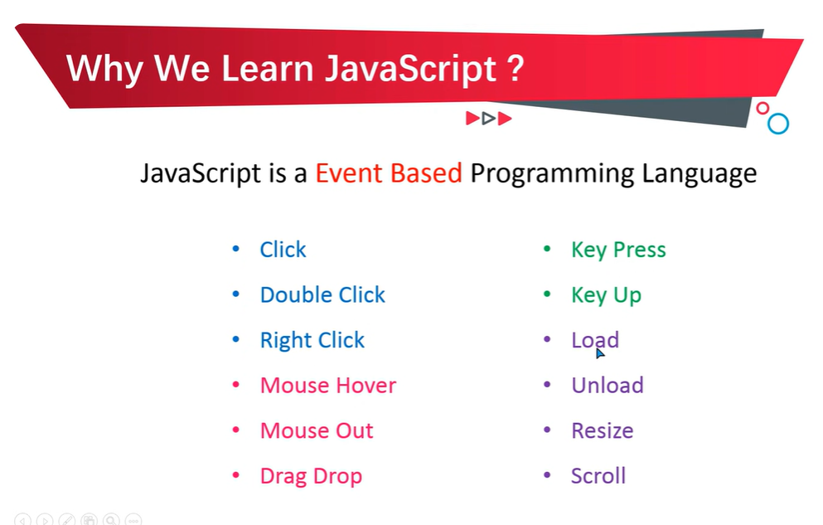

Slide 5
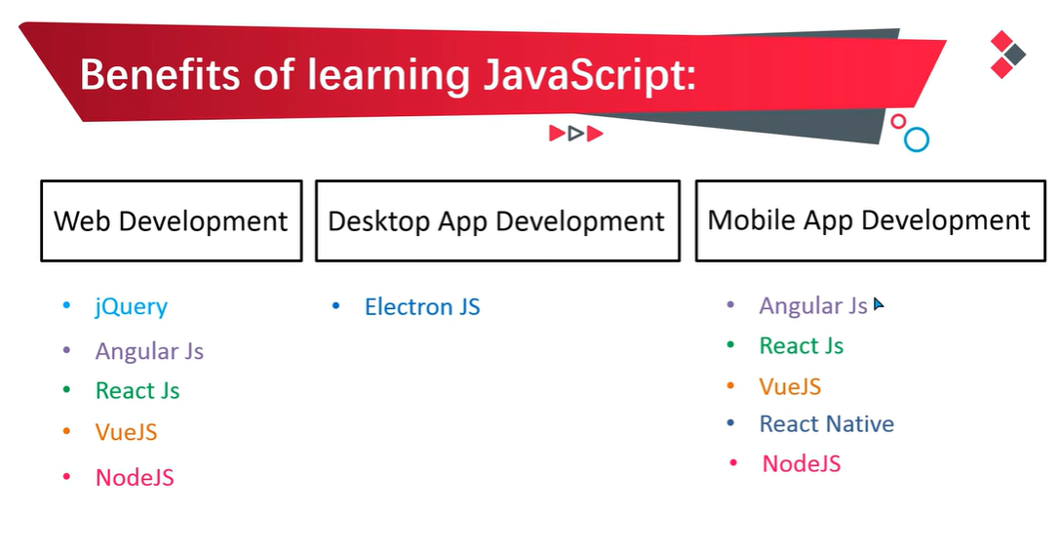

Slide 6
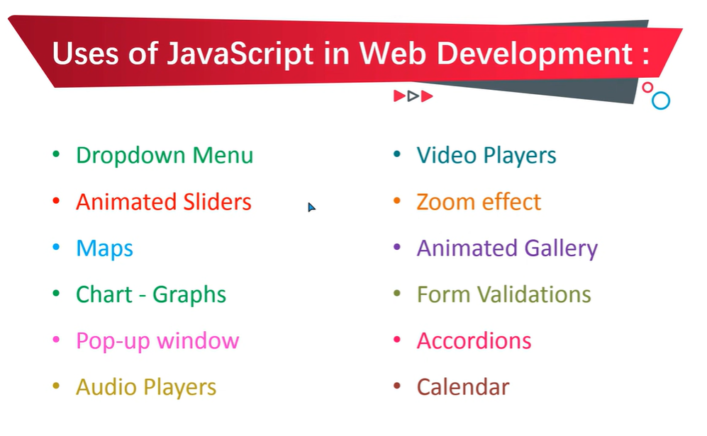

Slide 7
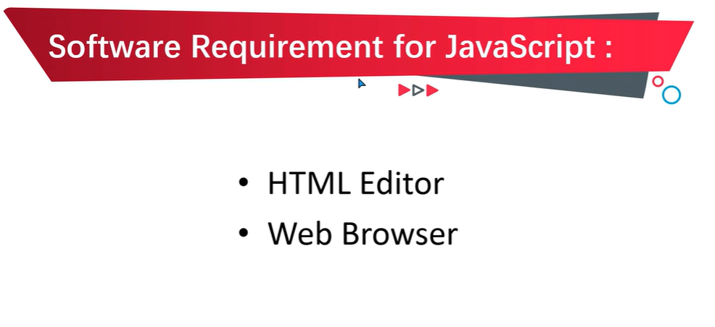

Slide 8
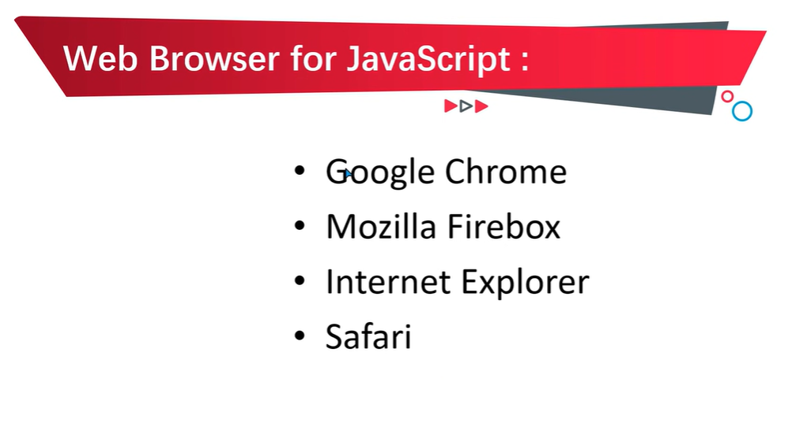

Slide 9
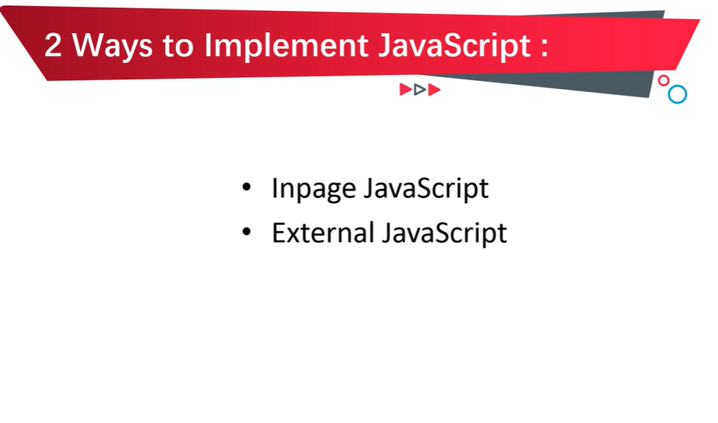

Slide 10
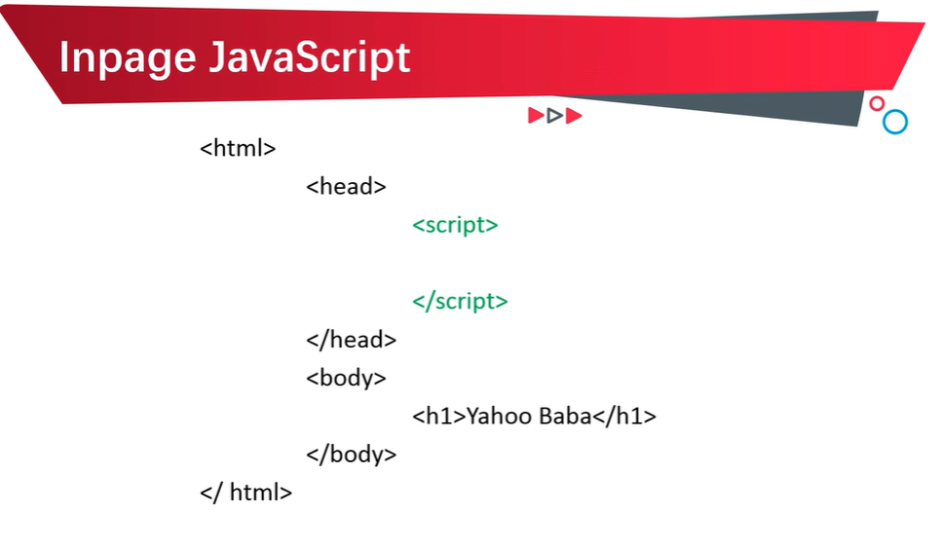

Slide 11
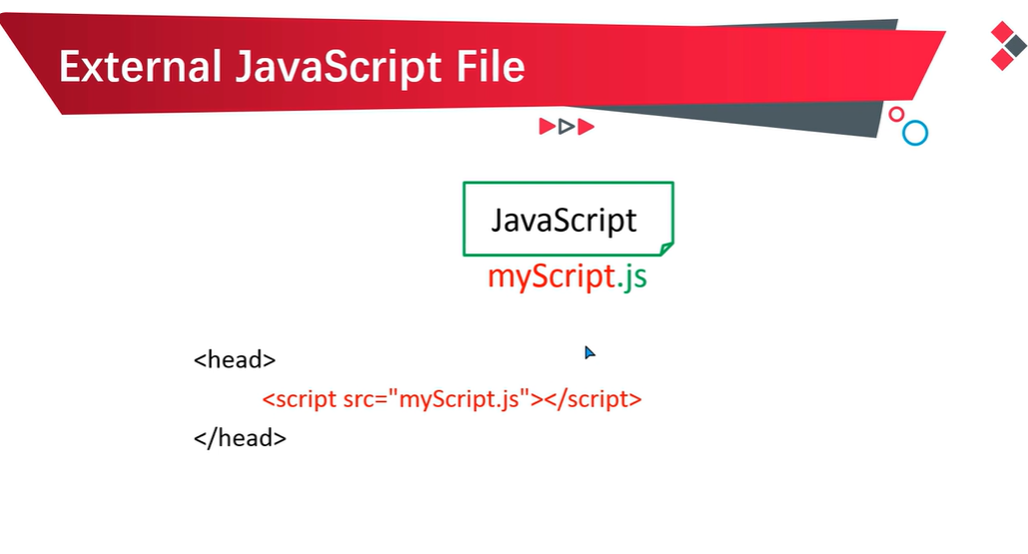

Slide 12
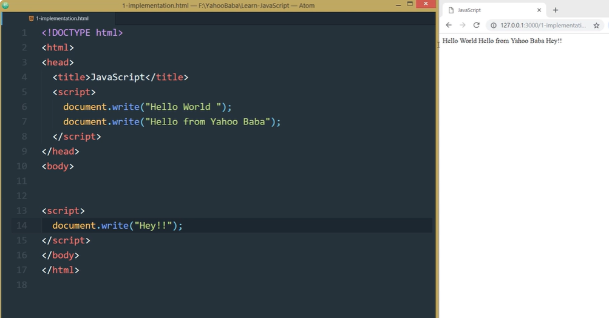
INPAGE JS

Slide 13
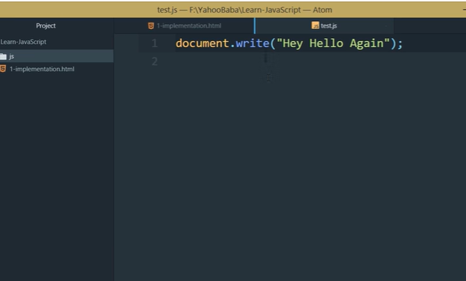
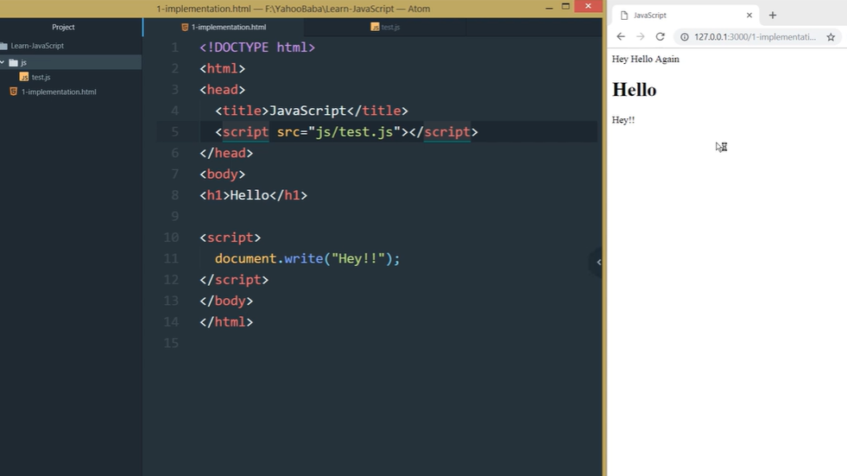
External JS
test.js

Slide 14
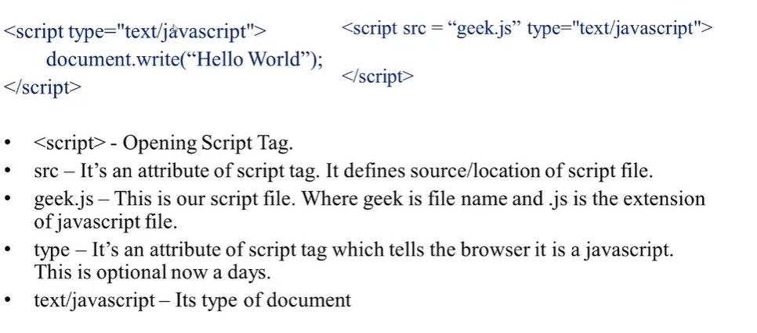
Basic Structure
Document.write() function is used to display the data on the webpage.

Slide 15
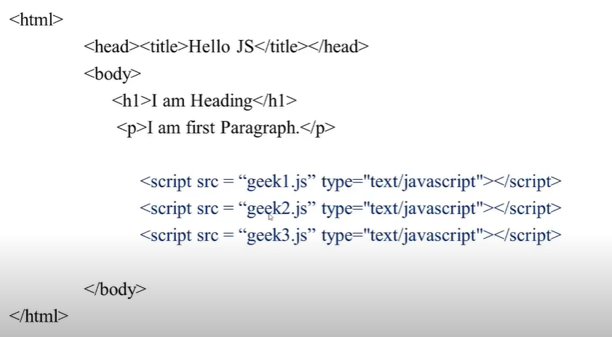
Linking more than one javascript file.

Slide 16
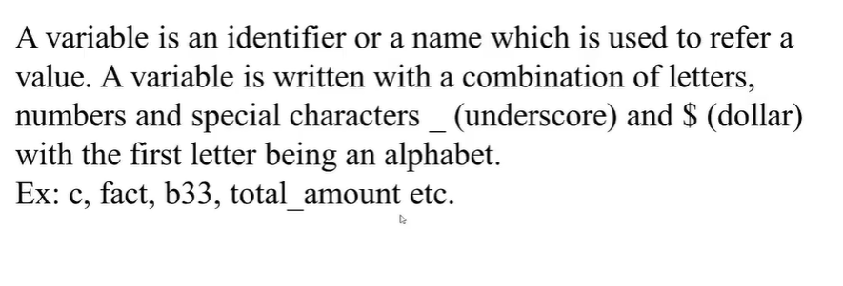
Variable

Slide 17
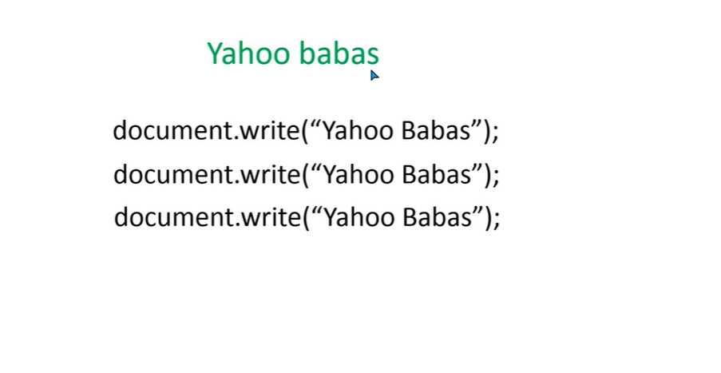
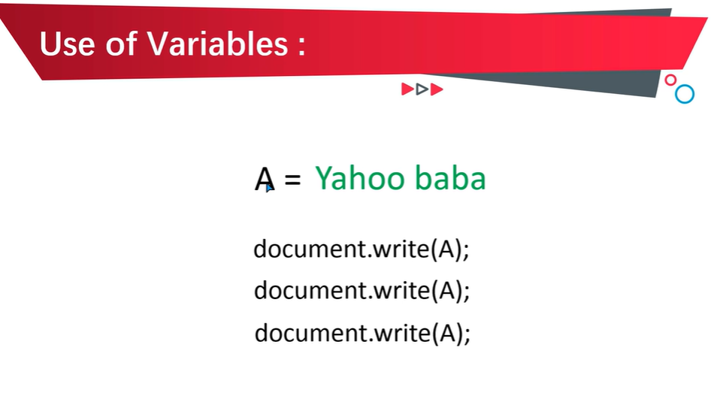

Slide 18
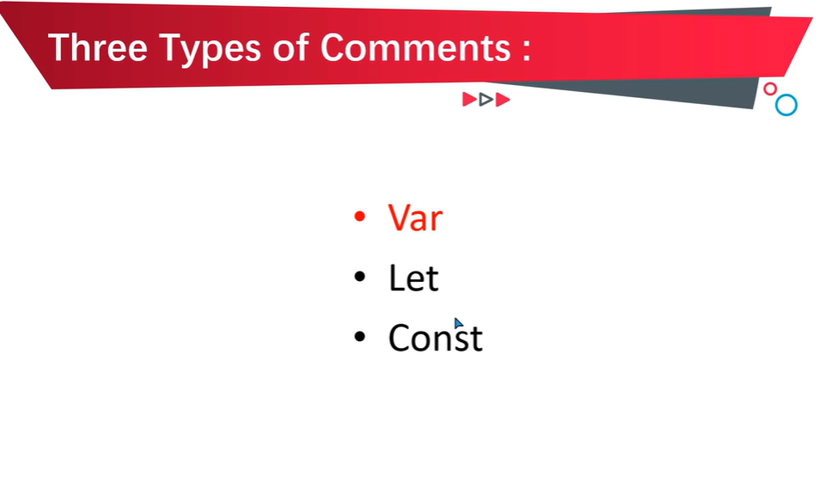

Slide 19
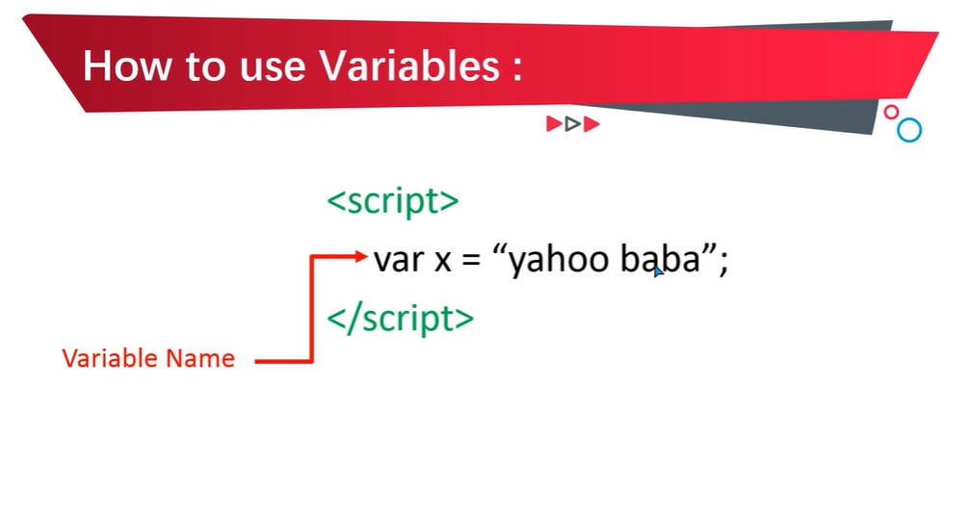

Slide 20
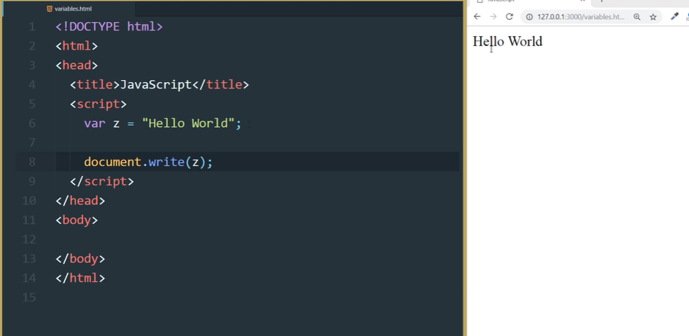

Slide 21
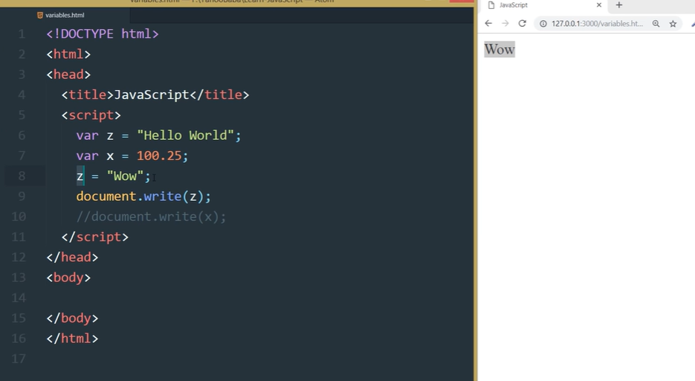

Slide 22
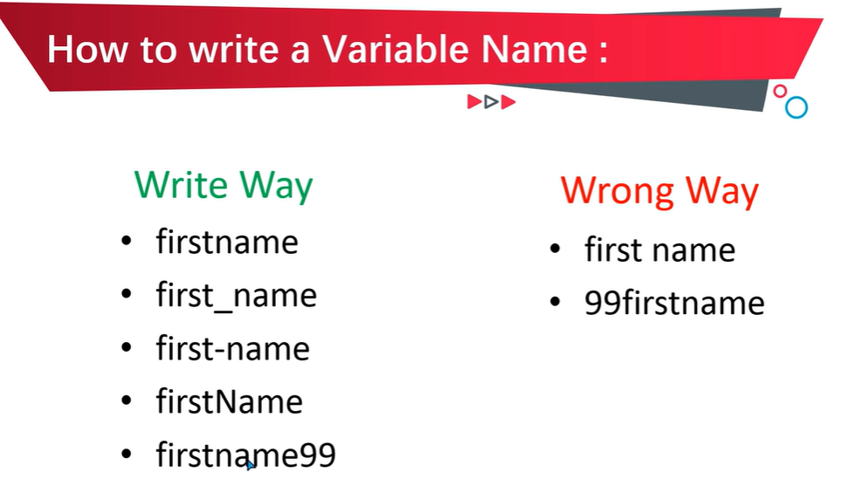

Slide 23
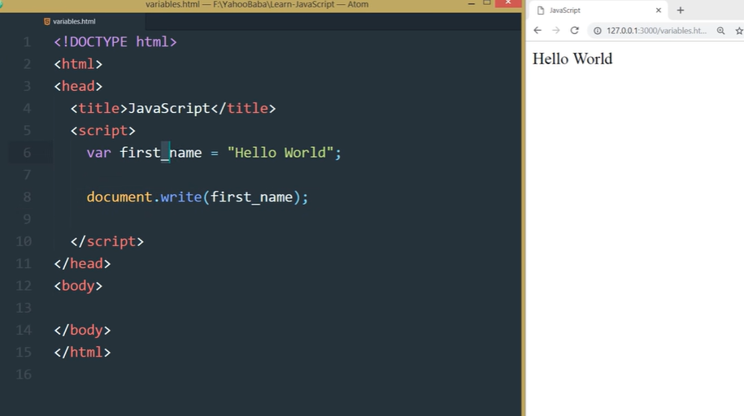

Slide 24
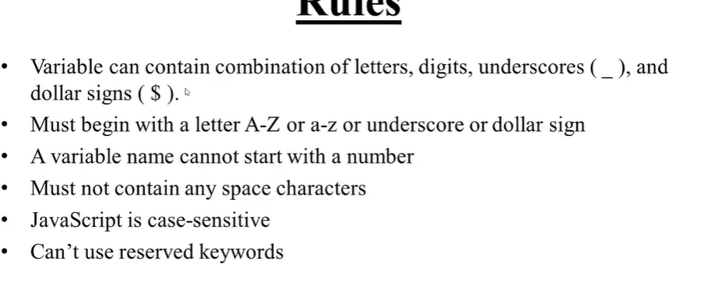
Rules for defining the variables-

Slide 25
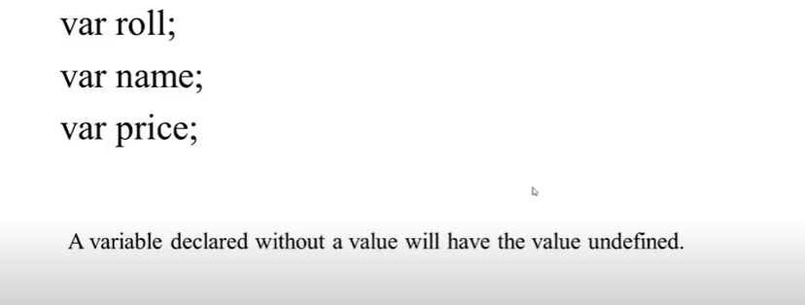
Declaring variable

Slide 26
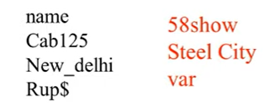
Declaring variable
Invalid Declaration
Valid variable Declaration

Slide 27
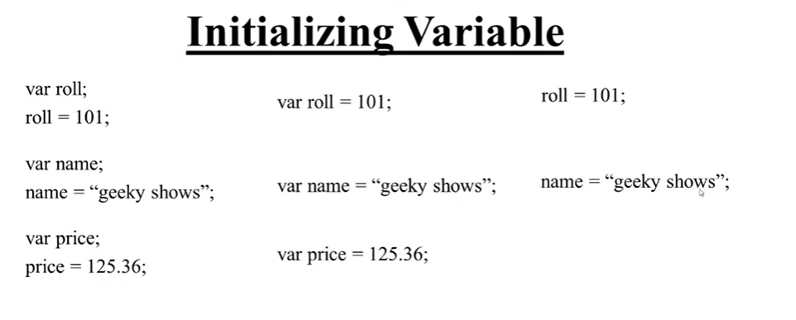
Direct variable initialisation
Good Practice is to write the var datatype for each variable

Slide 28
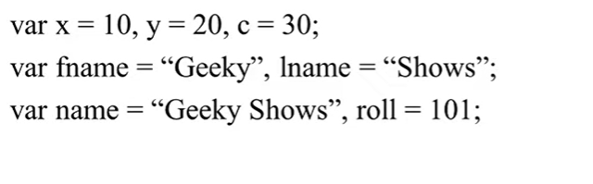
Multiple initialisation of a variable.

Slide 29
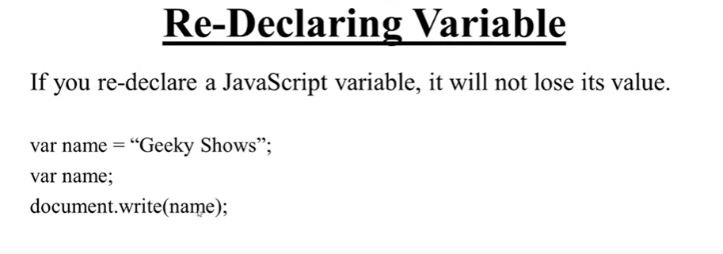

Slide 30
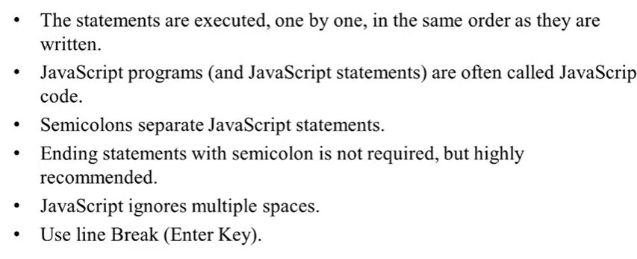

Slide 31
JavaScript Constant
The const keyword was introduced in ES6 (2015)
Variables defined with const cannot be Redeclared
Variables defined with const cannot be Reassigned

Slide 32
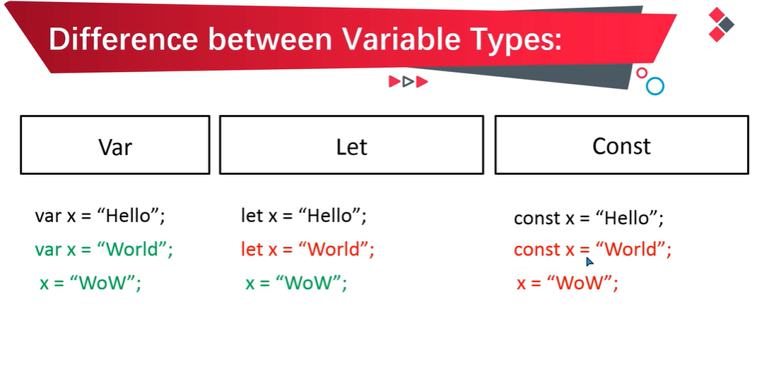

Slide 33
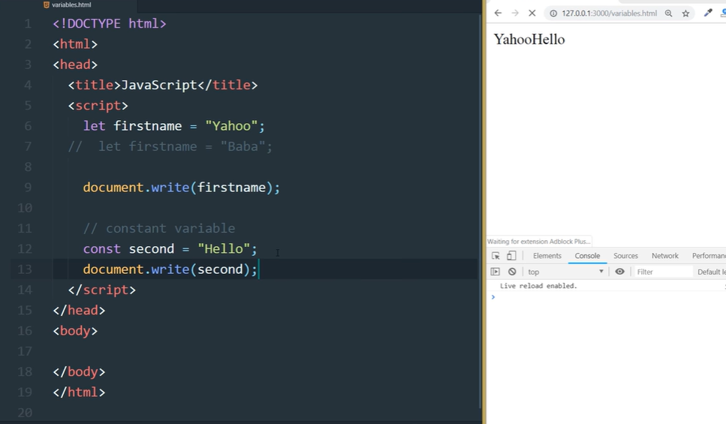
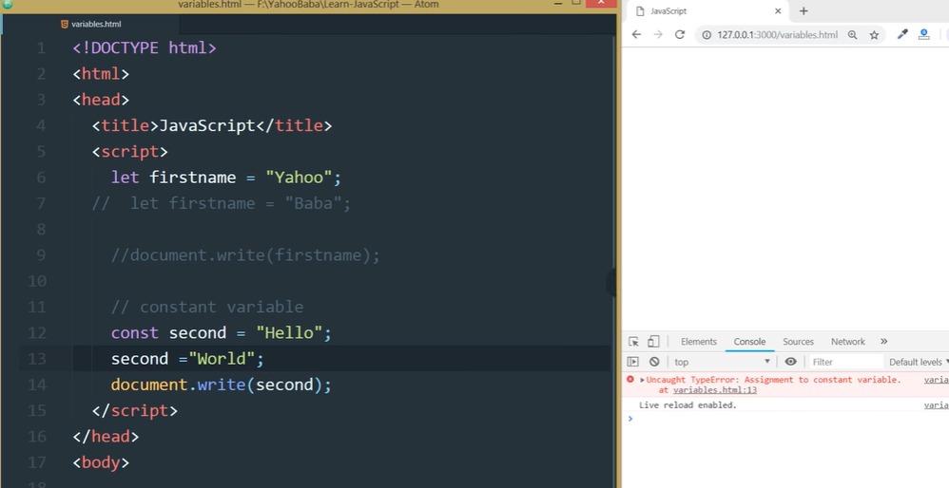

Slide 34
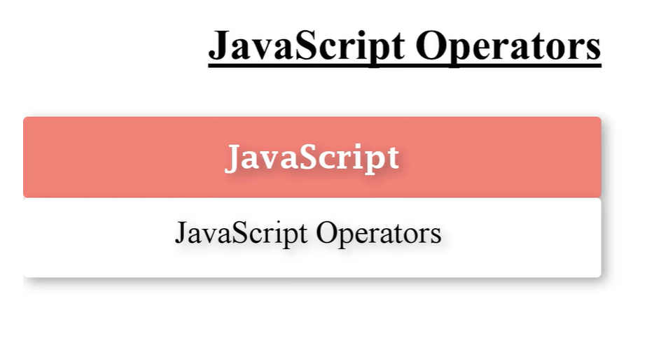

Slide 35
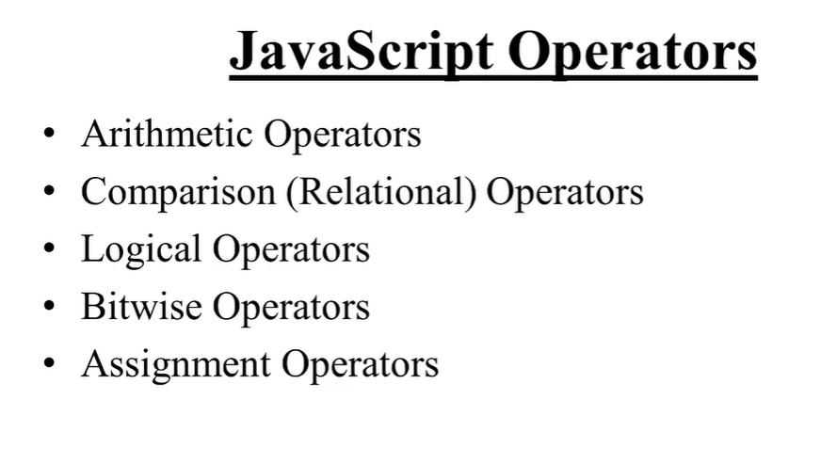

Slide 36
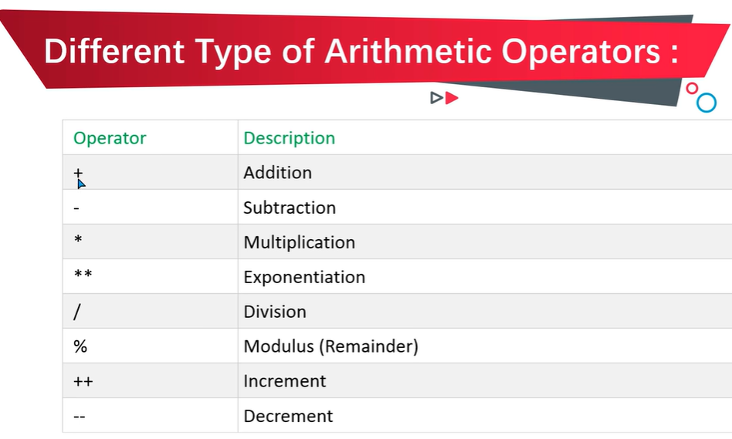
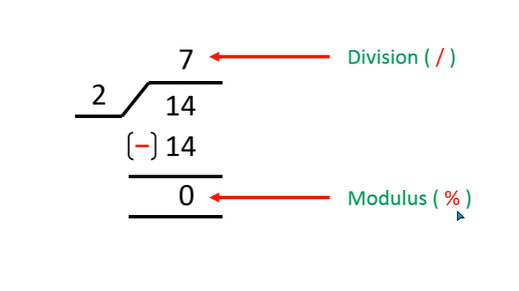

Slide 37
<!DOCTYPE html>
<html>
<body>
<h1>JavaScript Arithmetic</h1>
<h2>The ++ Operator</h2>
<script>
let x = 20;
let y = 10;
let sum = x+y;
let sub = x-y;
let mul = x*y;
let div = x/y;
let mod = x%y;
let b = 2
let exp = b**b;
x++
let z = x;
y--
let a = y;
document.write("Addition:" +sum + "<br>");
document.write("Subtration:" +sub + "<br>");
document.write("Multiplication:" +mul + "<br>");
document.write("Division:" +div + "<br>");
document.write("Modulus:" +mod + "<br>");
document.write("Exponent:" +exp + "<br>");
document.write("Increment:" +z + "<br>");
document.write("Decrement:" +a + "<br>");
</script>
</body>
</html>

Slide 38
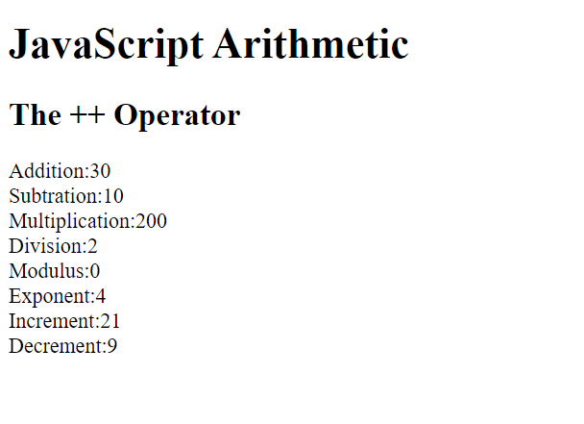

Slide 39
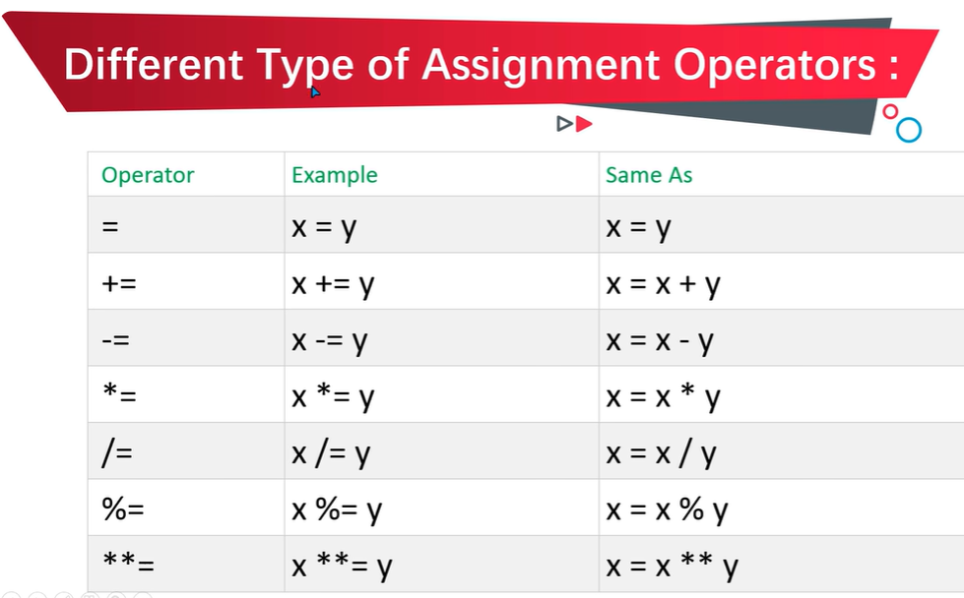

Slide 40
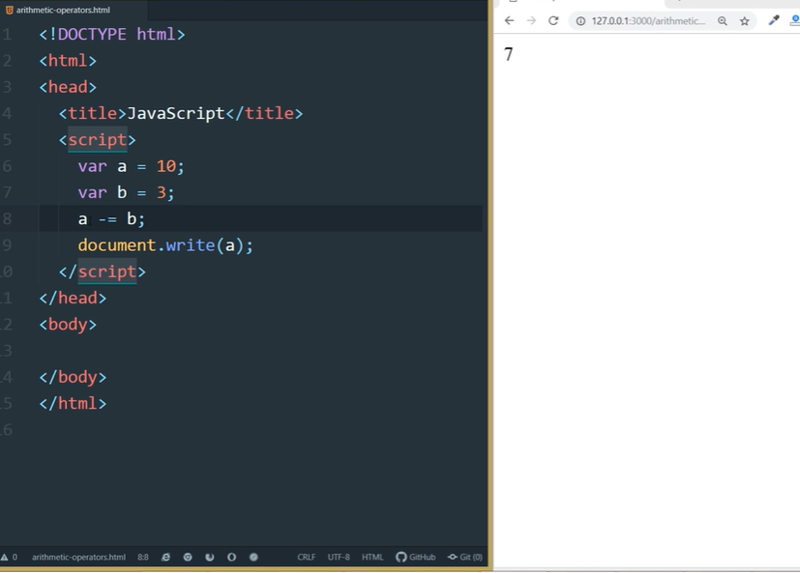
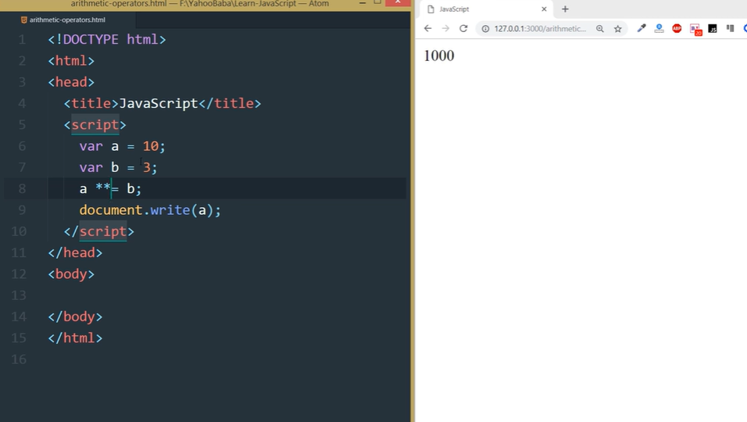

Slide 41
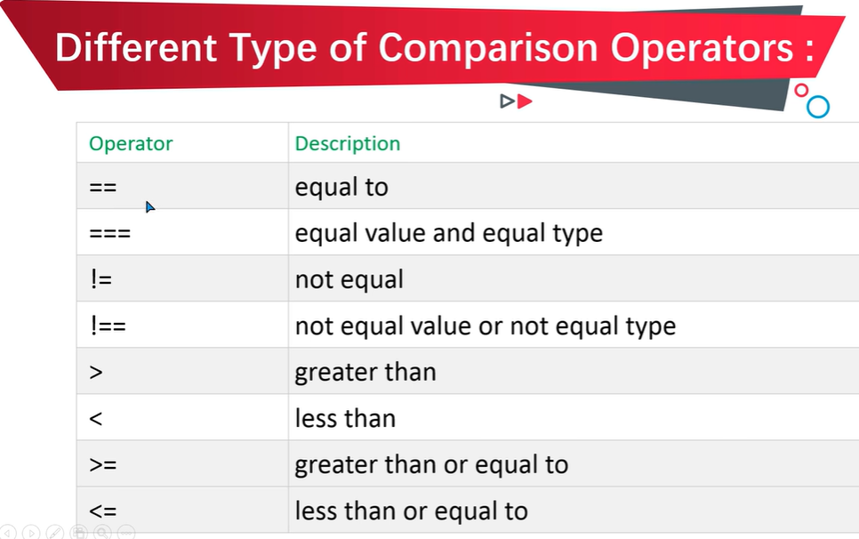

Slide 42
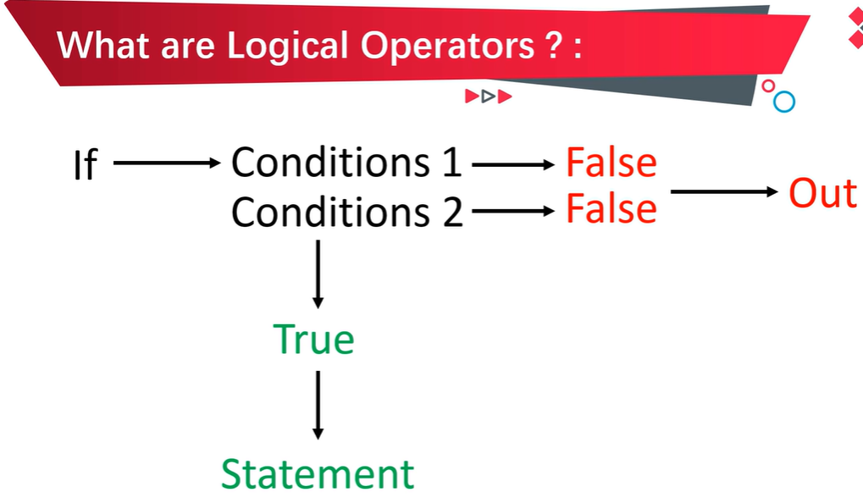

Slide 43
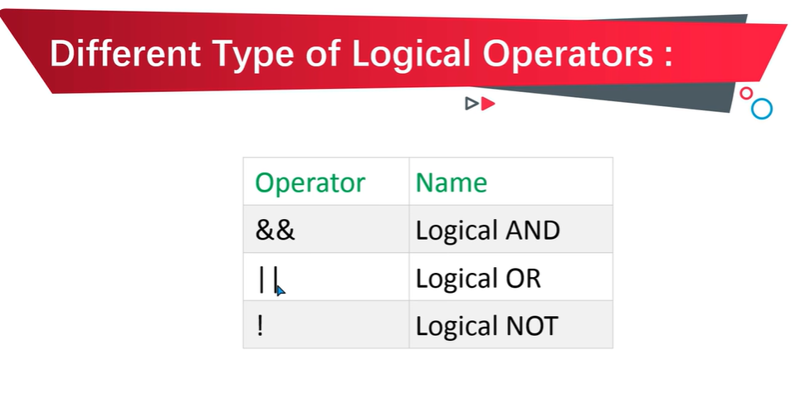

Slide 44
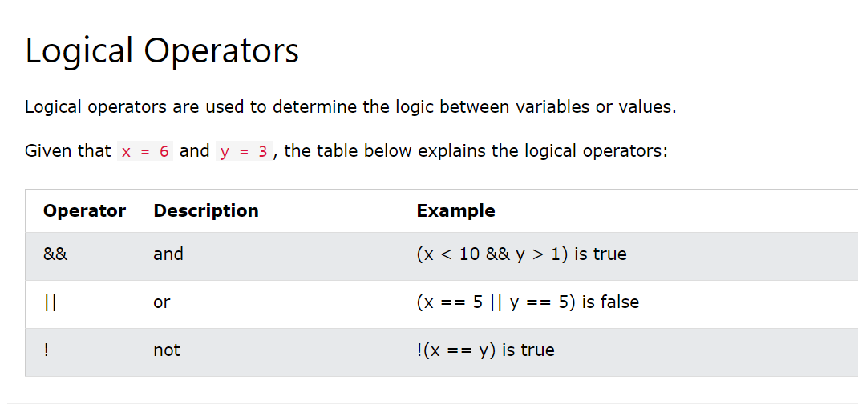

Slide 45
Logical AND Operator
If Condition A and Condition B both are True, then it will Return True.
If Any of the one Condition is False either A or B, then it will return False.
If Both Conditions A and B are False, then it will return False.
Condition A | Condition B | Result
True | True | True
True | False | False
False | True | False
False | False | False

Slide 46
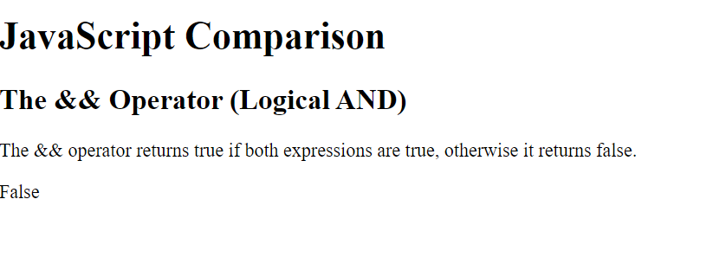
<!DOCTYPE html>
<html>
<body>
<h1>JavaScript Comparison</h1>
<h2>The && Operator (Logical AND)</h2>
<p>The && operator returns true if both expressions are true, otherwise it returns false.</p>
<script>
let a = 10
let b = 20
if(a==10 && b!=20){
document.write("True")
}
else{
document.write("False")
}
</script>
</body>
</html>
Logical AND Operator

Slide 47
Logical OR Operator
If Condition A and Condition B both are True, then it will Return True.
If Any of the one Condition is False either A or B, then it will return True.
If Both Conditions A and B are False, then it will return False.
Condition A | Condition B | Result
True | True | True
True | False | True
False | True | True
False | False | False

Slide 48
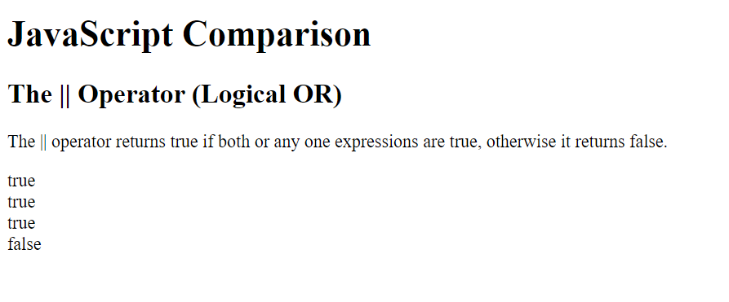
<!DOCTYPE html>
<html>
<body>
<h1>JavaScript Comparison</h1>
<h2>The || Operator (Logical OR)</h2>
<p>The || operator returns true if both or any one expressions are true, otherwise it returns false.</p>
<script>
let a = 10
let b = 20
document.write(a == 10 || b == 20, "<br>")
document.write(a < 10 || b == 20 , "<br>")
document.write(a != 10 || b == 20 , "<br>")
document.write(a != 10 || b != 20)
</script>
</body>
</html>

Slide 49
Logical NOT Operator
If Statement is True then Logical NOT (!) Operator returns False.
If Statement is False then Logical Not(!) Operator returns True.
Statement | Result
True | False
False | True

Slide 51
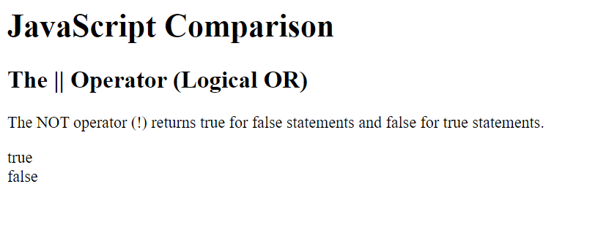
<!DOCTYPE html>
<html>
<body>
<h1>JavaScript Comparison</h1>
<h2>The || Operator (Logical OR)</h2>
<p>The NOT operator (!) returns true for false statements and false for true statements.</p>
<script>
let a = 10
let b = 20
document.write(! (a == b), "<br>")
document.write(! (a != b))
</script>
</body>
</html>

Slide 52
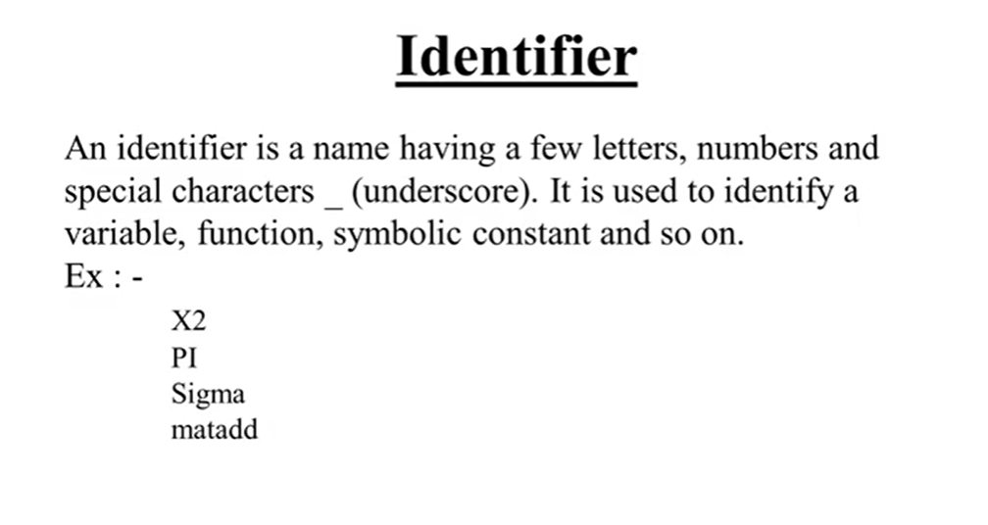

Slide 53
Control Statements
JavaScript control statement is used to control the execution of a program based on a specific condition. If the condition meets then a particular block of action will be executed otherwise it will execute another block of action that satisfies that particular condition.
Types of Control Statements in JavaScript
Conditional Statement: These statements are used for decision-making, a decision is made by the conditional statement based on an expression that is passed. Either YES or NO.
Iterative Statement: This is a statement that iterates repeatedly until a condition is met. Simply said, if we have an expression, the statement will keep repeating itself until and unless it is satisfied.

Slide 54
There are several methods that can be used to perform control statements in JavaScript.
If Statement
Using If-Else Statement
Using If Else-if else Statement
Using Switch Statement

Slide 55
If Statement
Syntax:
if ( condition_is_given_here ) { // If the condition is met, //the code will get executed. }

Slide 56
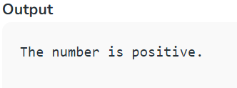
const num = 5;
if (num > 0) {
console.log("The number is positive.");
};

Slide 57

If else Statement
The if-else statement will perform some action for a specific condition. If the condition meets then a particular code of action will be executed otherwise it will execute another code of action that satisfies that particular condition.

Slide 58

let num = -10;
if (num > 0)
console.log("The number is positive.");
else
console.log("The number is negative");

Slide 59


Slide 60

const num = 5;
if (num > 0) {
console.log("The number is positive.");
}
else if (num == 0){
console.log("The number is positive.");
}
else{
console.log("The number is negative.");
};

Slide 61

Switch Statement
The switch case statement in JavaScript is also used for decision-making purposes.
In some cases, using the switch case statement is seen to be more convenient than if-else statements.

Slide 62

let num = 1;
switch (num) {
case 0:
console.log("Number is zero.");
break;
case 1:
console.log("Number is one.");
break;
case 2:
console.log("Number is two.");
break;
default:
console.log(“Default");
};

Slide 63


Slide 64

<script>
let day = 3;
let dayName;
switch (day) {
case 1:
dayName = 'Sunday';
break;
case 2:
dayName = 'Monday';
break;
case 3:
dayName = 'Tuesday';
break;
case 4:
dayName = 'Wednesday';
break;
case 5:
dayName = 'Thursday';
break;
case 6:
dayName = 'Friday';
break;
case 7:
dayName = 'Saturday';
break;
default:
dayName = 'Invalid day';
}
document.write("The day is" + " " + dayName);
</script>

Slide 65
JavaScript Loops
The JavaScript loops are used to iterate the piece of code using for, while, do while loops. It makes the code compact. It is mostly used in array.
There are four types of loops in JavaScript.
for loop
while loop
do-while loop

Slide 66

LOOPS in JAVASCRIPT

Slide 67


Slide 68

While Loop
The JavaScript while loop iterates the elements for the infinite number of times. It should be used if number of iteration is not known. The syntax of while loop is given below.
<script>
var i = 11;
while ( i<=15 )
{
document.write(i + "<br/>");
i++;
}
</script>

Slide 69

Do-while Loop
The JavaScript do while loop iterates the elements for the infinite number of times like while loop. But, code is executed at least once whether condition is true or false. The syntax of do while loop is given below.
<script>
var i=21;
do{
document.write(i + "<br/>");
i++;
}while (i<=25);
</script>

Slide 70

For Loop
The JavaScript for loop iterates the elements for the fixed number of times. It should be used if number of iteration is known. The syntax of for loop is given below.
<script>
for (i=1; i<=5; i++)
{
document.write(i + "<br/>")
}
</script>

Slide 71
Array
An array is a special variable, which can hold more than one value.
const cars = ["Saab", "Volvo", "BMW"];

Slide 72


Slide 73

ARRAYS in JAVASCRIPT

Slide 74


Slide 75



Slide 76

ARRAYS METHODS
The slice() method returns selected elements in an array, as a new array.

Slide 77



Slide 78

The splice() method is used to add or remove elements of an existing array and the return value will be the removed items from the array.

Slide 79


Slide 80





Slide 81



Slide 82



Slide 83


<body>
<h1>JavaScript Arrays</h1>
<h2>The join() Method</h2>
<script>
const fruits = ["Banana", "Orange", "Apple", "Mango"];
document.write(fruits.join(" * "));
</script>
</body>

Slide 84
concat()
The concat() method is used to concatenate two or more arrays and it gives the merged array.
Syntax
let newArray = arr.concat() // or
let newArray = arr1.concat(arr2) // or
let newArray = arr1.concat(arr2, arr3, ...) // or
let newArray = arr1.concat(value0, value1)

Slide 85
let arr1 = [11, 12, 13];
let arr2 = [14, 15, 16];
let arr3 = [17, 18, 19];
let newArr = arr1.concat(arr2, arr3);
console.log(newArr);

